Slide 1







Suspending a work session
Battle of Britain Memorial Flight: Maintenance Portal

Slide 2
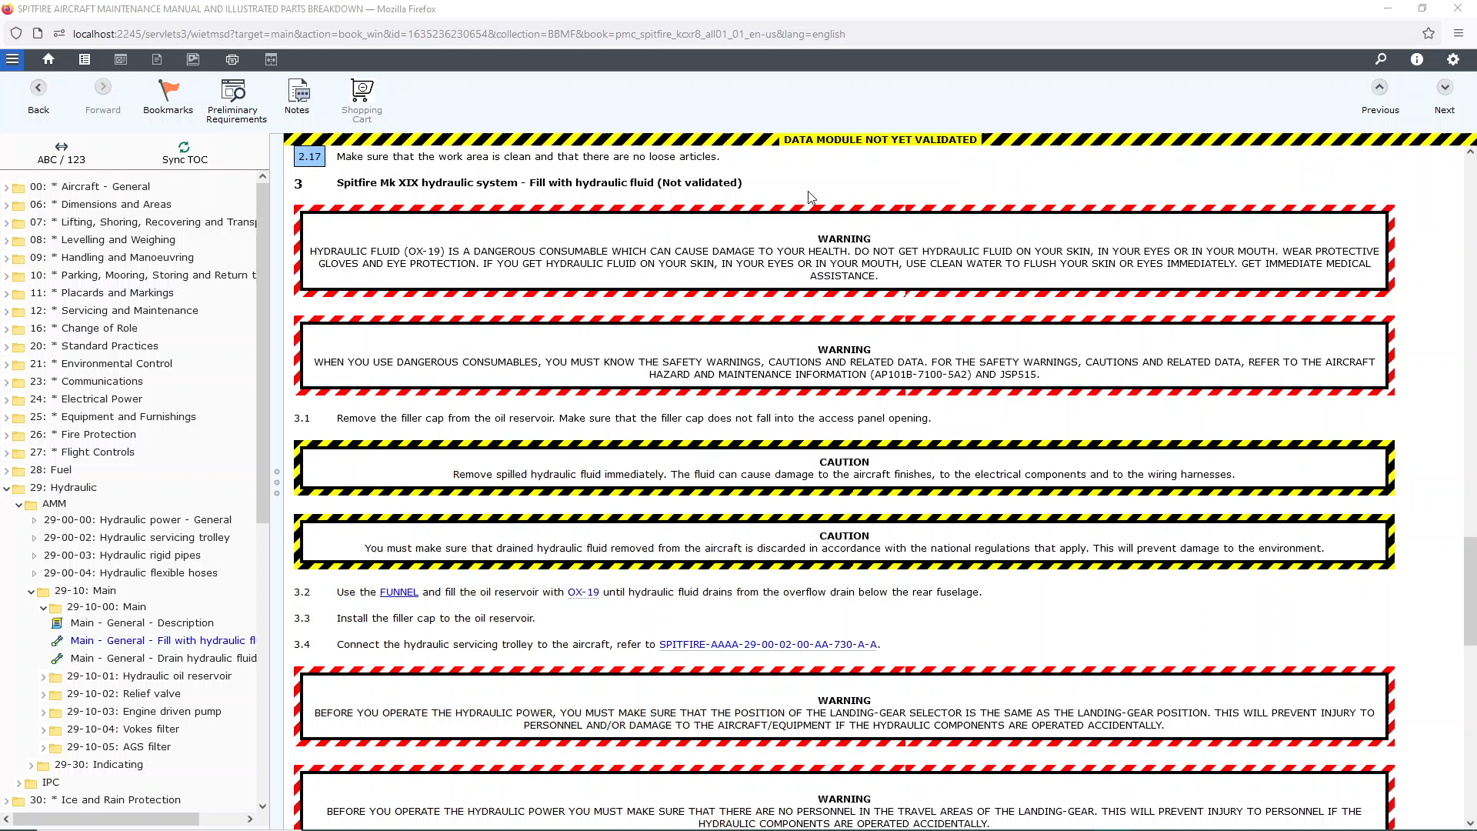
Notes:
The Suspend and Resume feature allows a user to stop a procedure, catch a snap shot of the progress, then continue the job in a separate LiveContent session.
In this example we see that a user has used the Next and Previous Step buttons to get to Step 2.17. This implies they have completed all steps up to but excluding Step 3.
***************************************************
To suspend this task they do the following:
Select “Suspend and Resume”.
Note: for the instance created, the title shows the DMC followed by a date and time stamp when the suspend was created.
***************************************************
Decide if this is a job only they should continue, or if they can leave as an option for other users…
They can save as Public or Private or for other members of their LiveContent user group.
[Save as Public]
Leave a meaningful comment [“Continue at Step 3”].
Then press “Suspend”.
They can now leave the session by selecting Settings > Exit, or by closing the window.
***************************************************
This new session is with a different user: they can go to “Suspend and Resume” and see a listing of unfinished jobs, in this example there are two instances, including one that the first user did not see. This is because one instance was private.
This user can select either session
[Select top job]
… then press “Resume” to see the details of the job.
***************************************************
Pressing “Resume” in the bottom right-hand corner, LiveContent will launch this task and position the Next / Previous Step marker at the last position.
NOTE: If the previous user did not use Next / Previous Step marker there will be no explicit start position for the next session.
***************************************************
When the job is complete one of two things should happen.
If they were the Creator of the original suspend session they can delete the Instance
If they were not the Creator, they should inform the creator the job is ready to be deleted

Slide 3


Slide 4
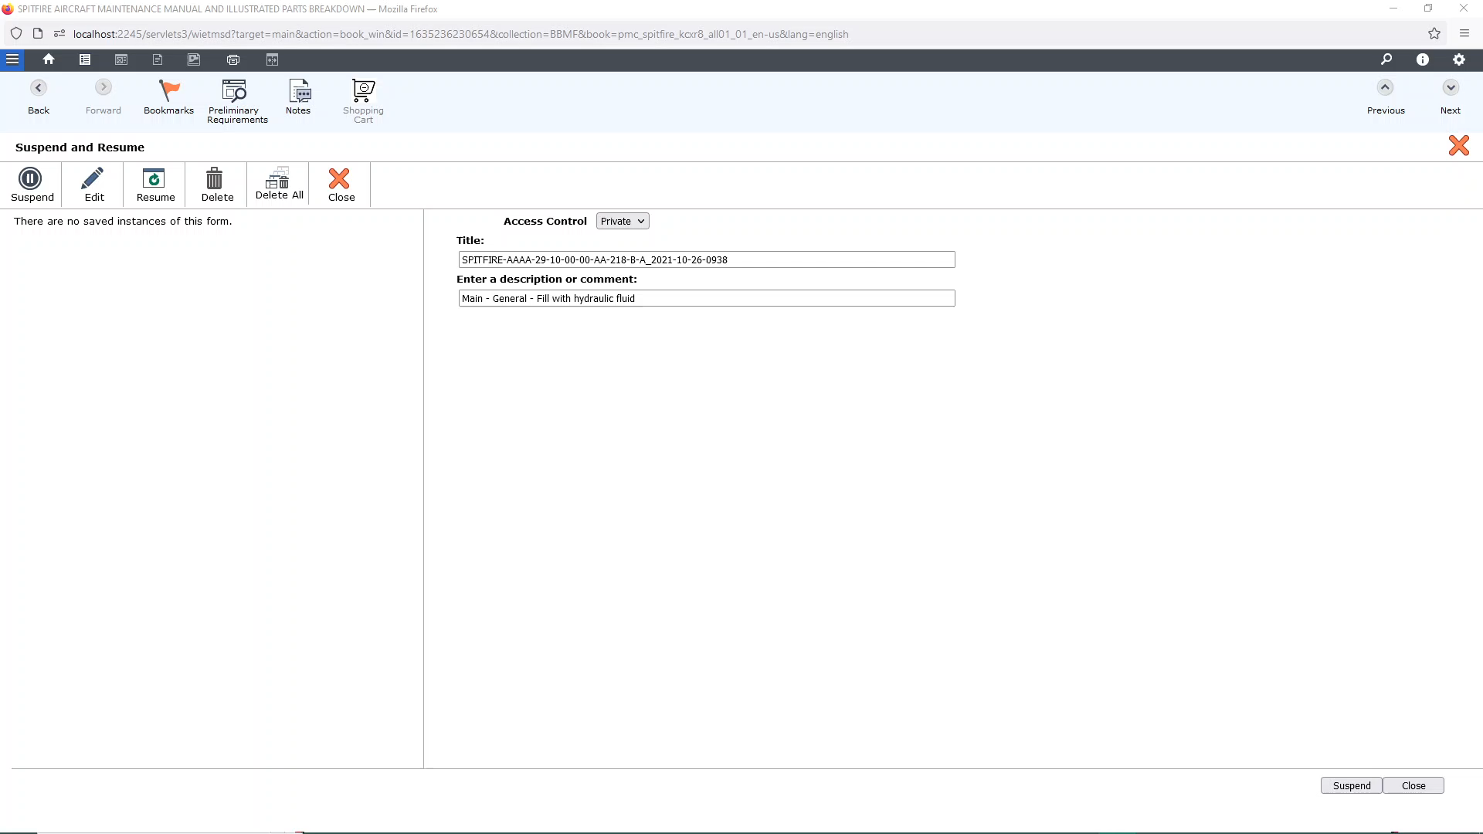

Slide 5
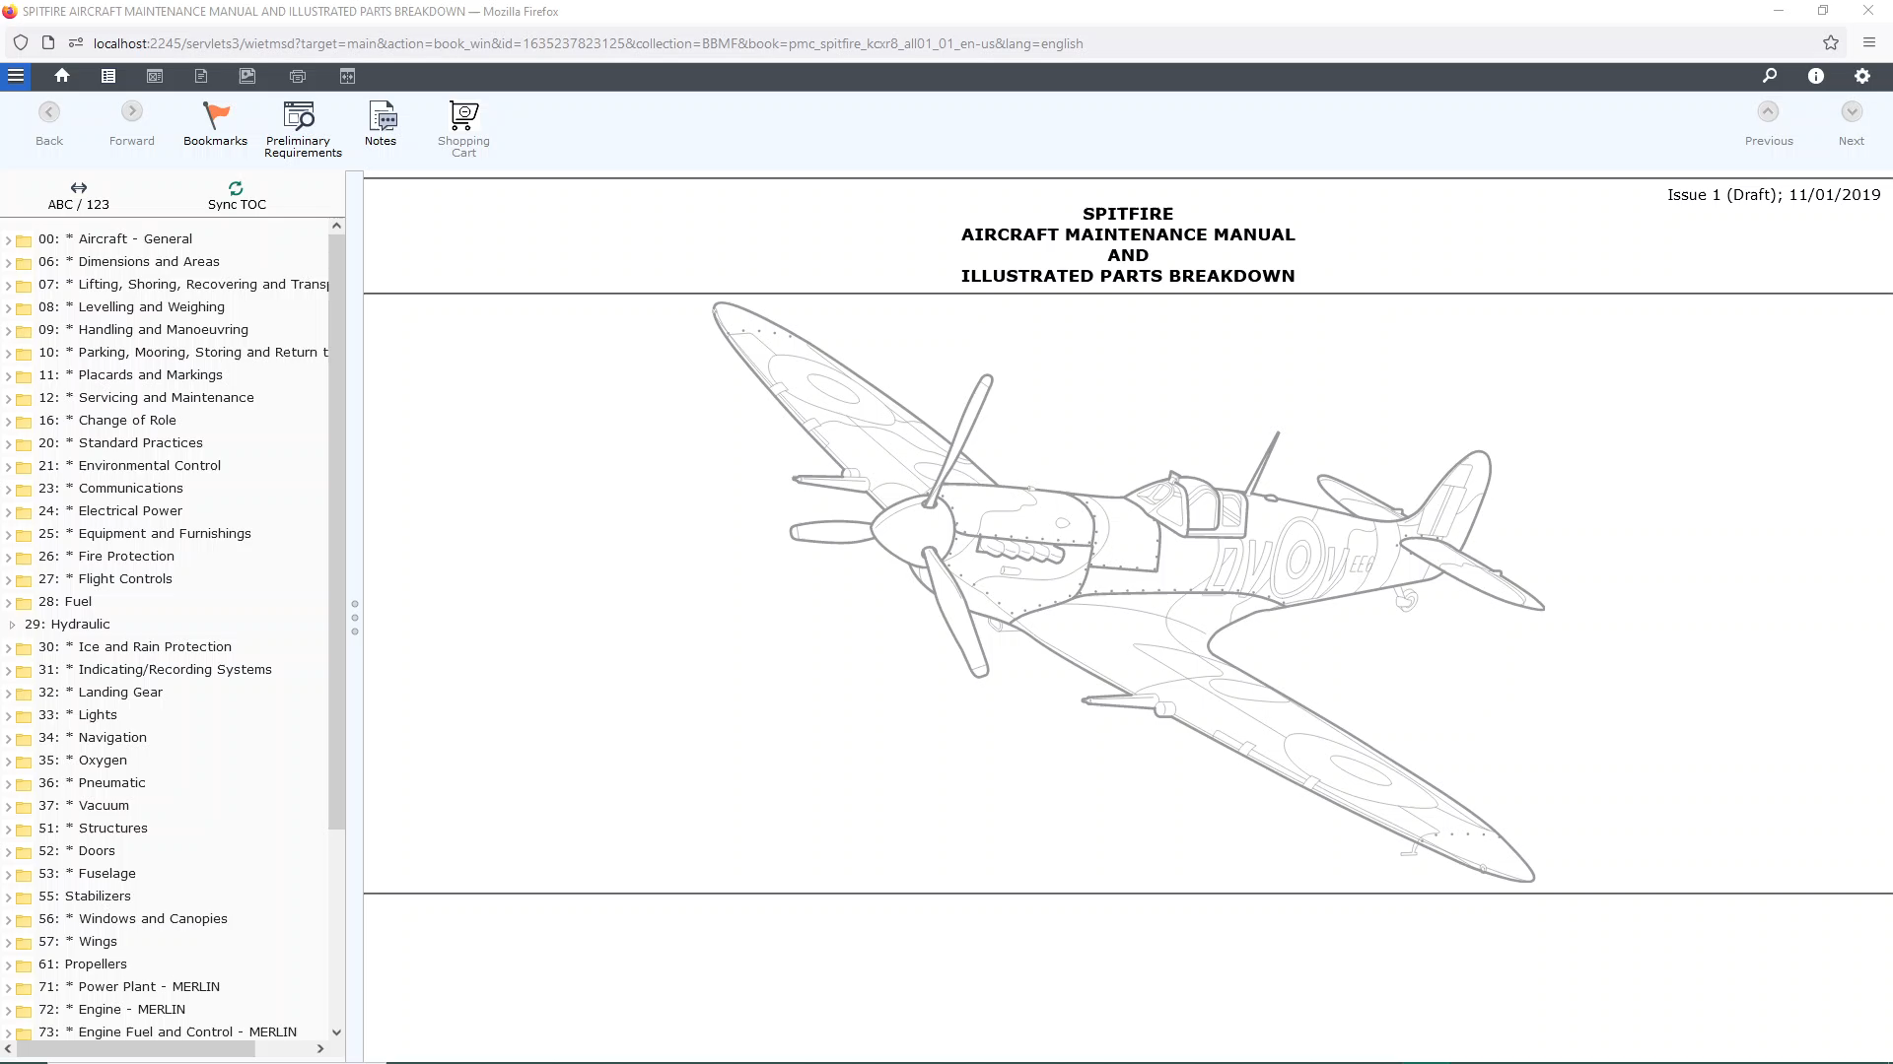

Slide 6
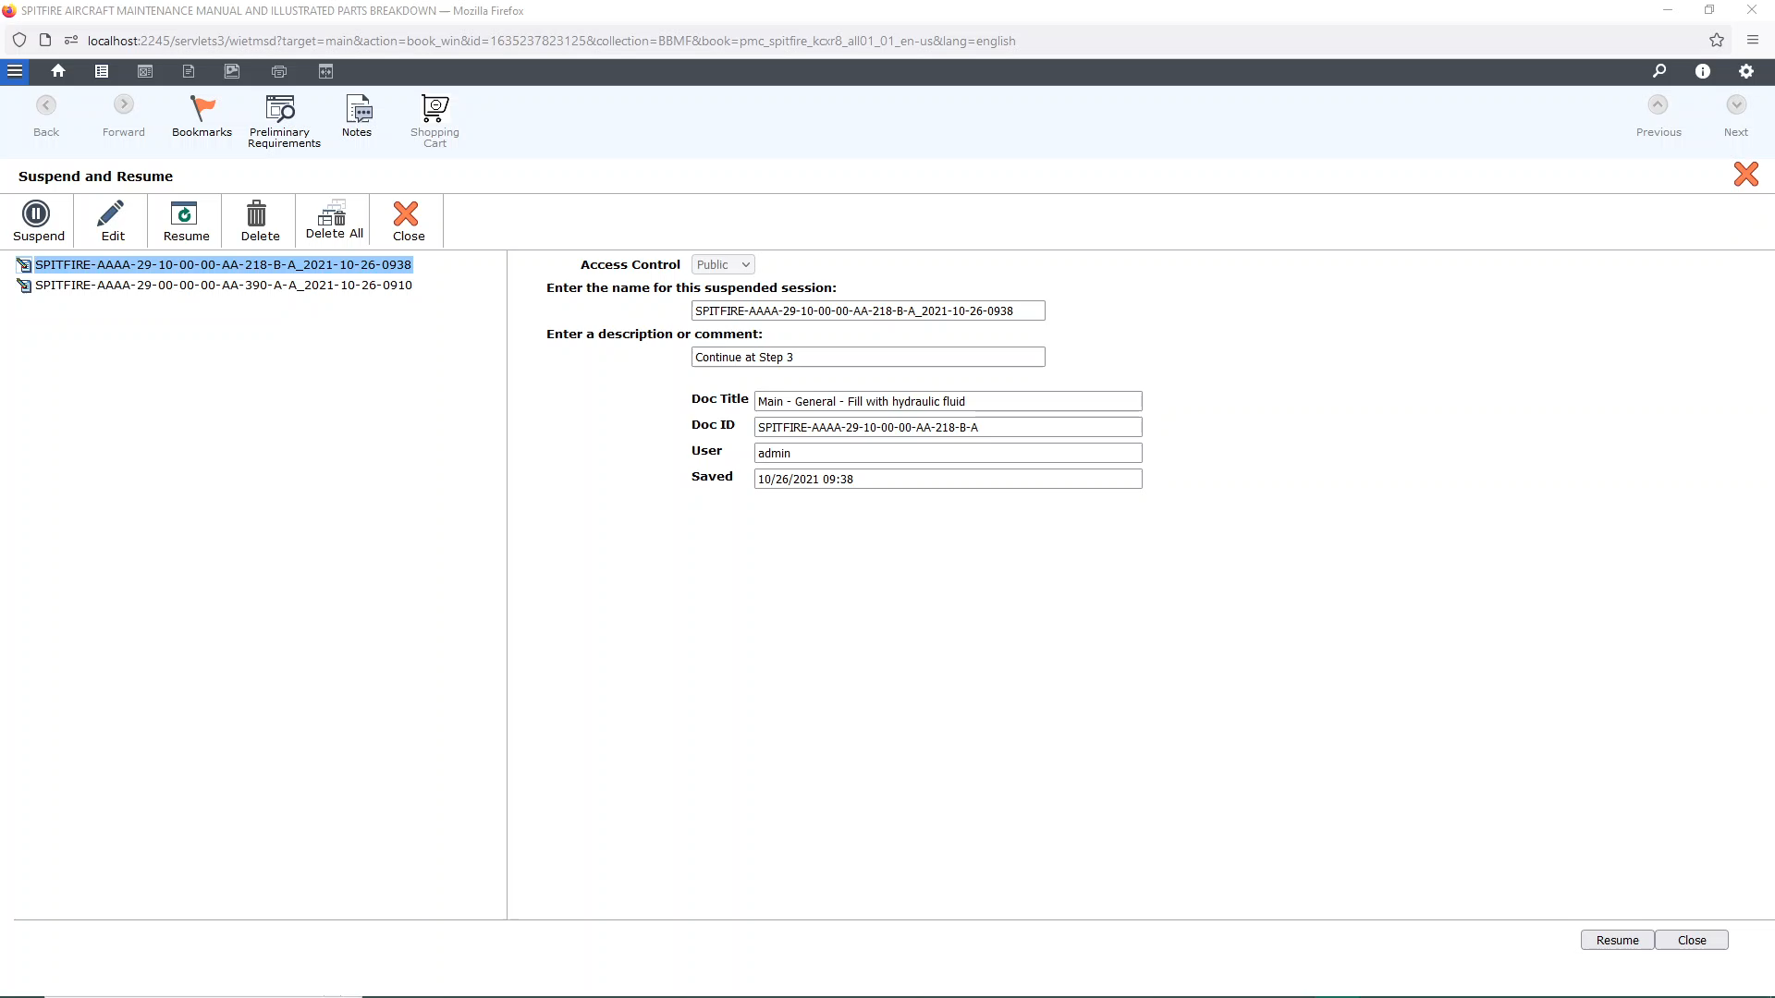

Slide 7
